Slide 1
ADRENAL Cortex
And its Pathology

Slide 2
Prof Dr Arun Jamkar,
M.S. Ph D( Surgical Oncology), FICS, FIAGES, FMAS, FAMS, FAIMER fellow
Ex Vice-Chancellor, Maharashtra University of Health Sciences, Nashik
Distinguished Professor, Symbiosis International University Pune
Consultant, Persistent systems ltd, Pune
Prof of surgery, B J Medical college Pune Grant medical college Mumbai
Director Academics, Galaxy care hospitals Pune
Ex Dean, B J Medical College Pune

Slide 3
Embryology
Adrenal Cortex:
Coelomic mesoderm
Cluster of cells between root of mesentery and genital ridge
Androgenic and Oestrogenic Tumor
Adrenal Medulla:
Develops as special portion chromafin system
from neuro ectoderm
Sympathoblast
Sympathogonia
Mature Ganglion cells

Slide 4
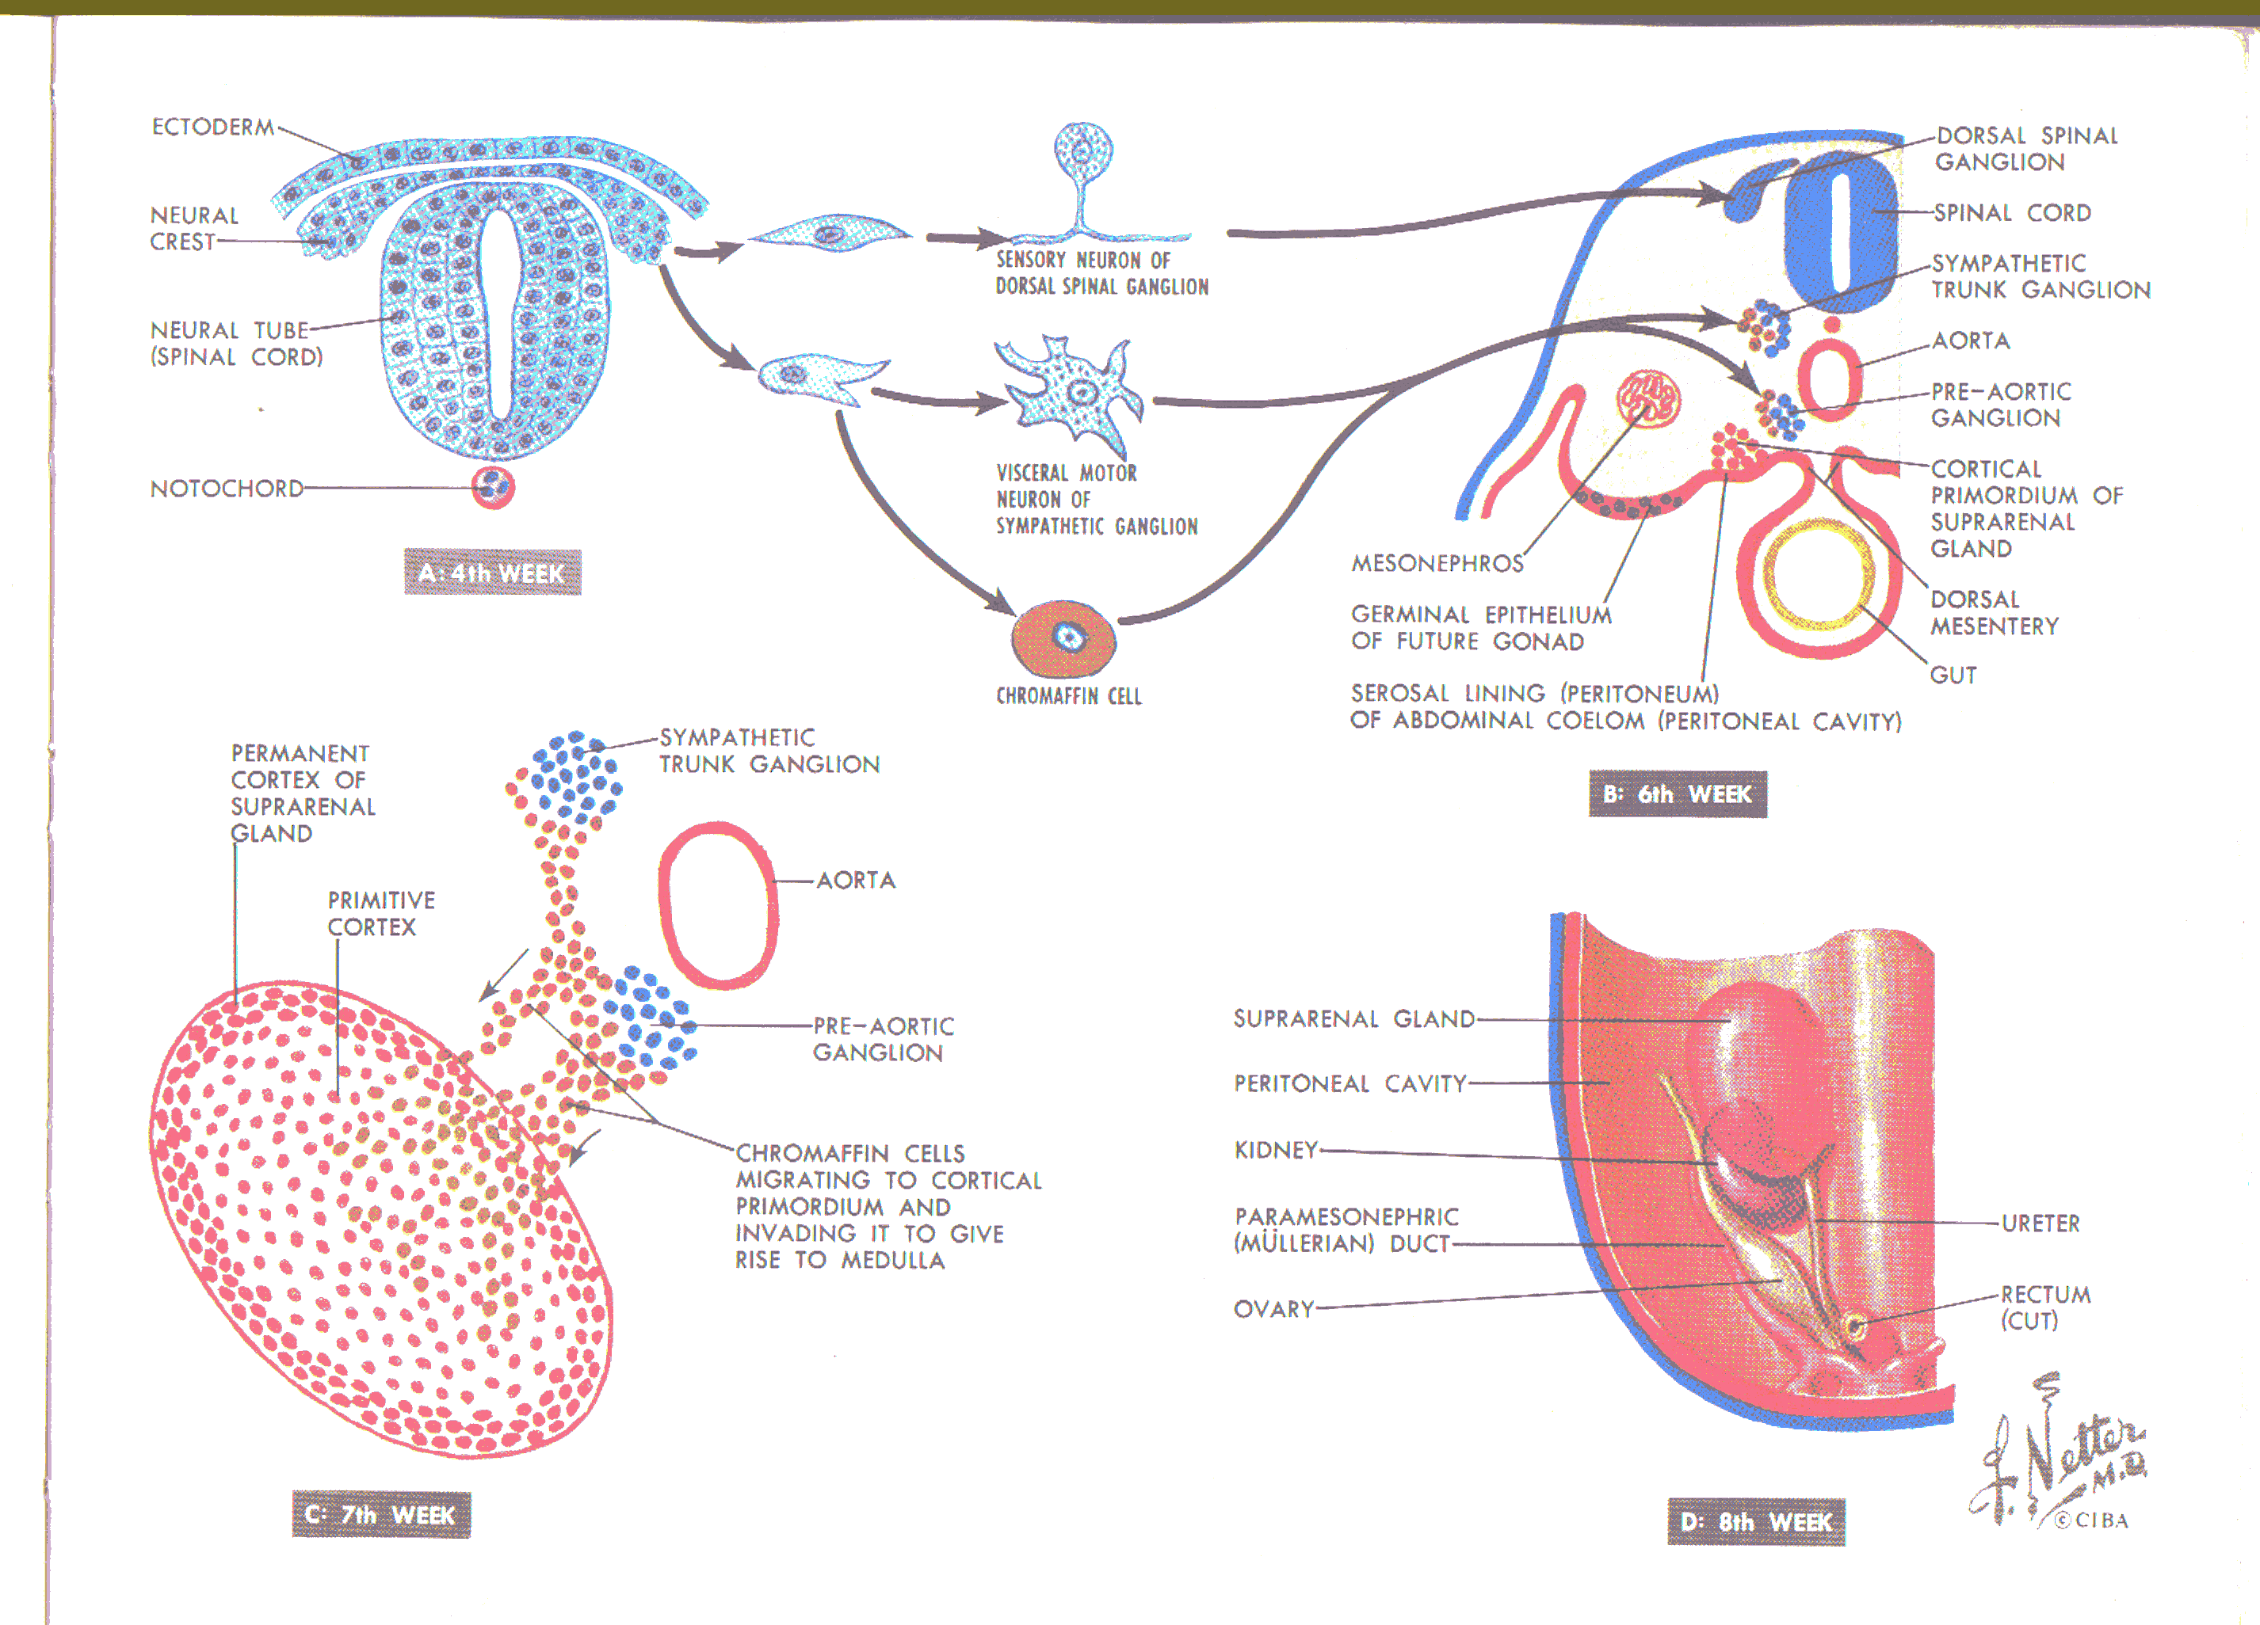

Slide 5
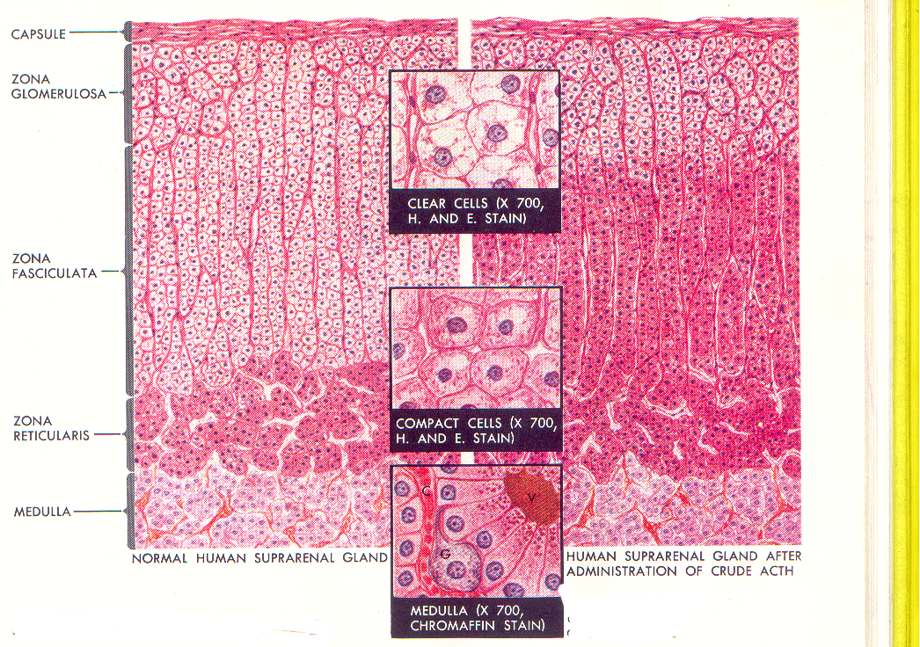
Histology:
Adrenal Cortex:
  Zona Glomerulosa
      Aldosterone
  Zona fasciculate
    Store house for cholesterol
  Zona reticularis
    Rest of hormones.
Adrenal Medulla
  Adrenaline, Noradrenaline

Slide 6
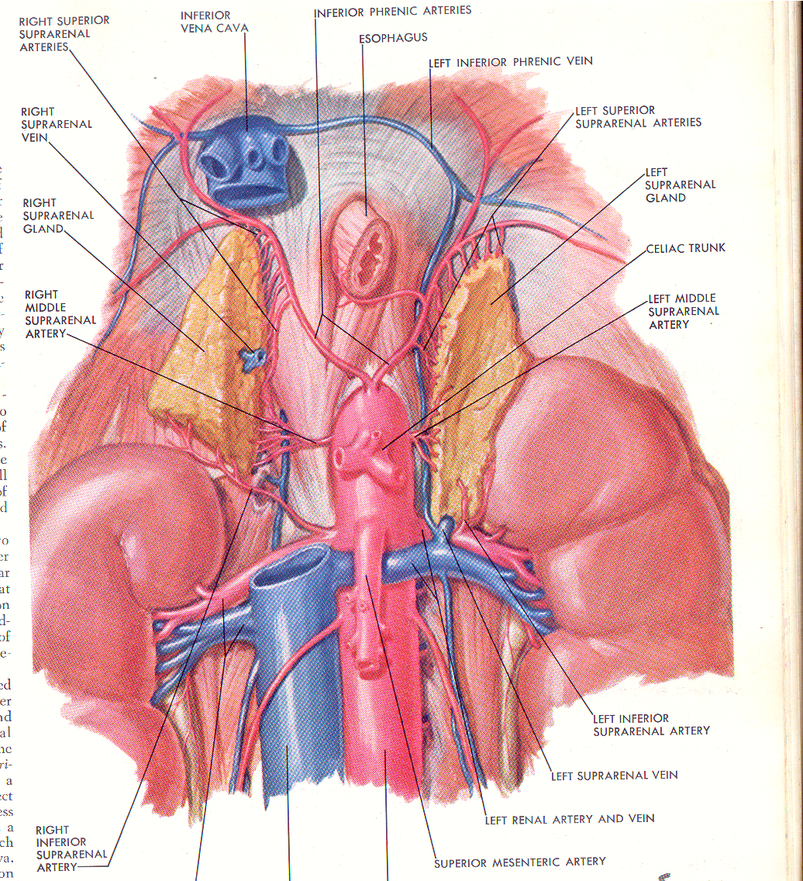
The superior adrenal artery, branch of inferior phrenic Artery
The middle adrenal artery, branch of abdominal aorta direct.
The inferior adrenal artery, branch of renal artery

Slide 7
The Adrenal gland,
Suprarenal gland
Enclosed, together with the kidney, within the renal fascia but a lamina of fibroareolar tissue separates the two structures, so that they occupy separate compartments.
Right adrenal is triangular in shape and
the left is semilunar

Slide 8
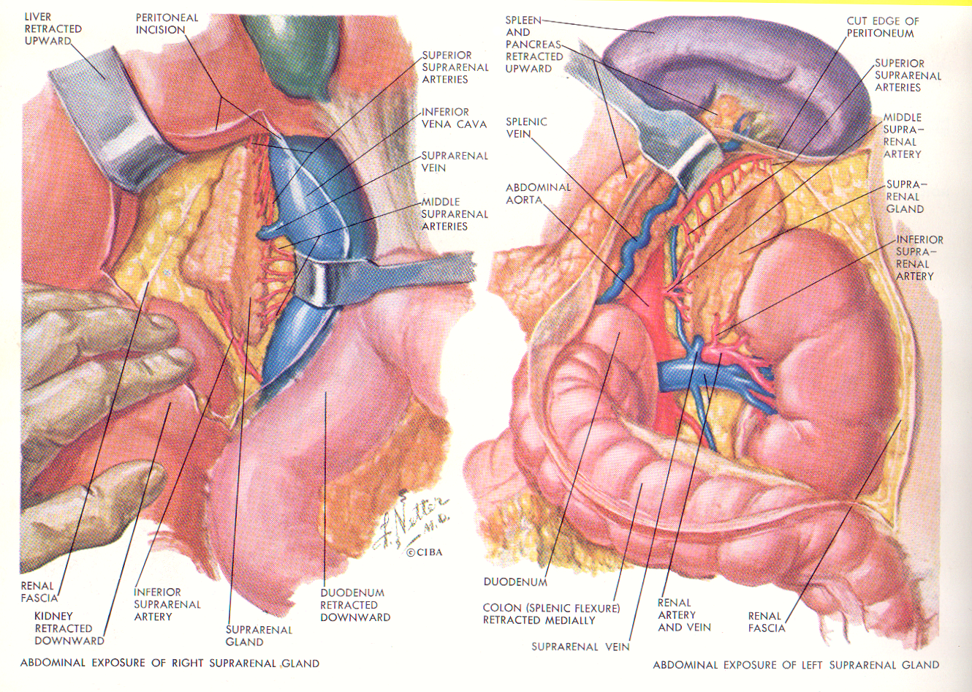
The Right adrenal vein is very short and drains directly into the inferior vena cava,.
The Left adrenal vein is longer and it drains into the left renal vein.

Slide 9
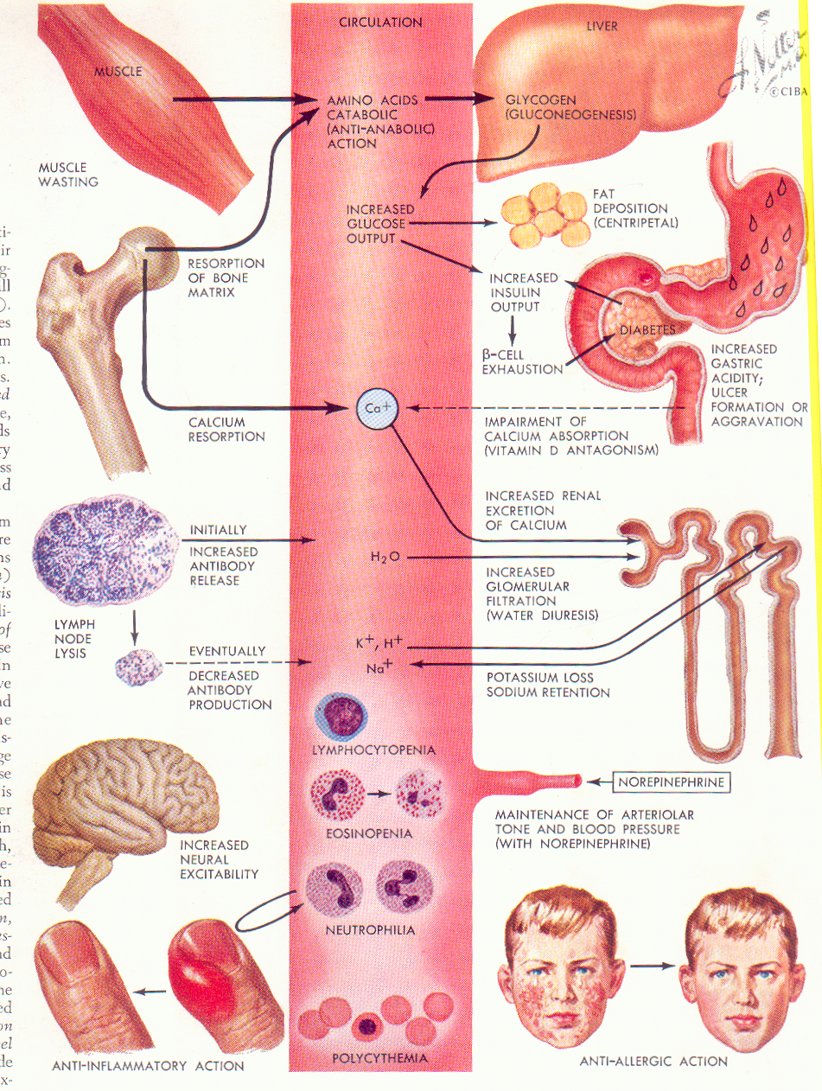
Actions of
steroid
hormones

Slide 10
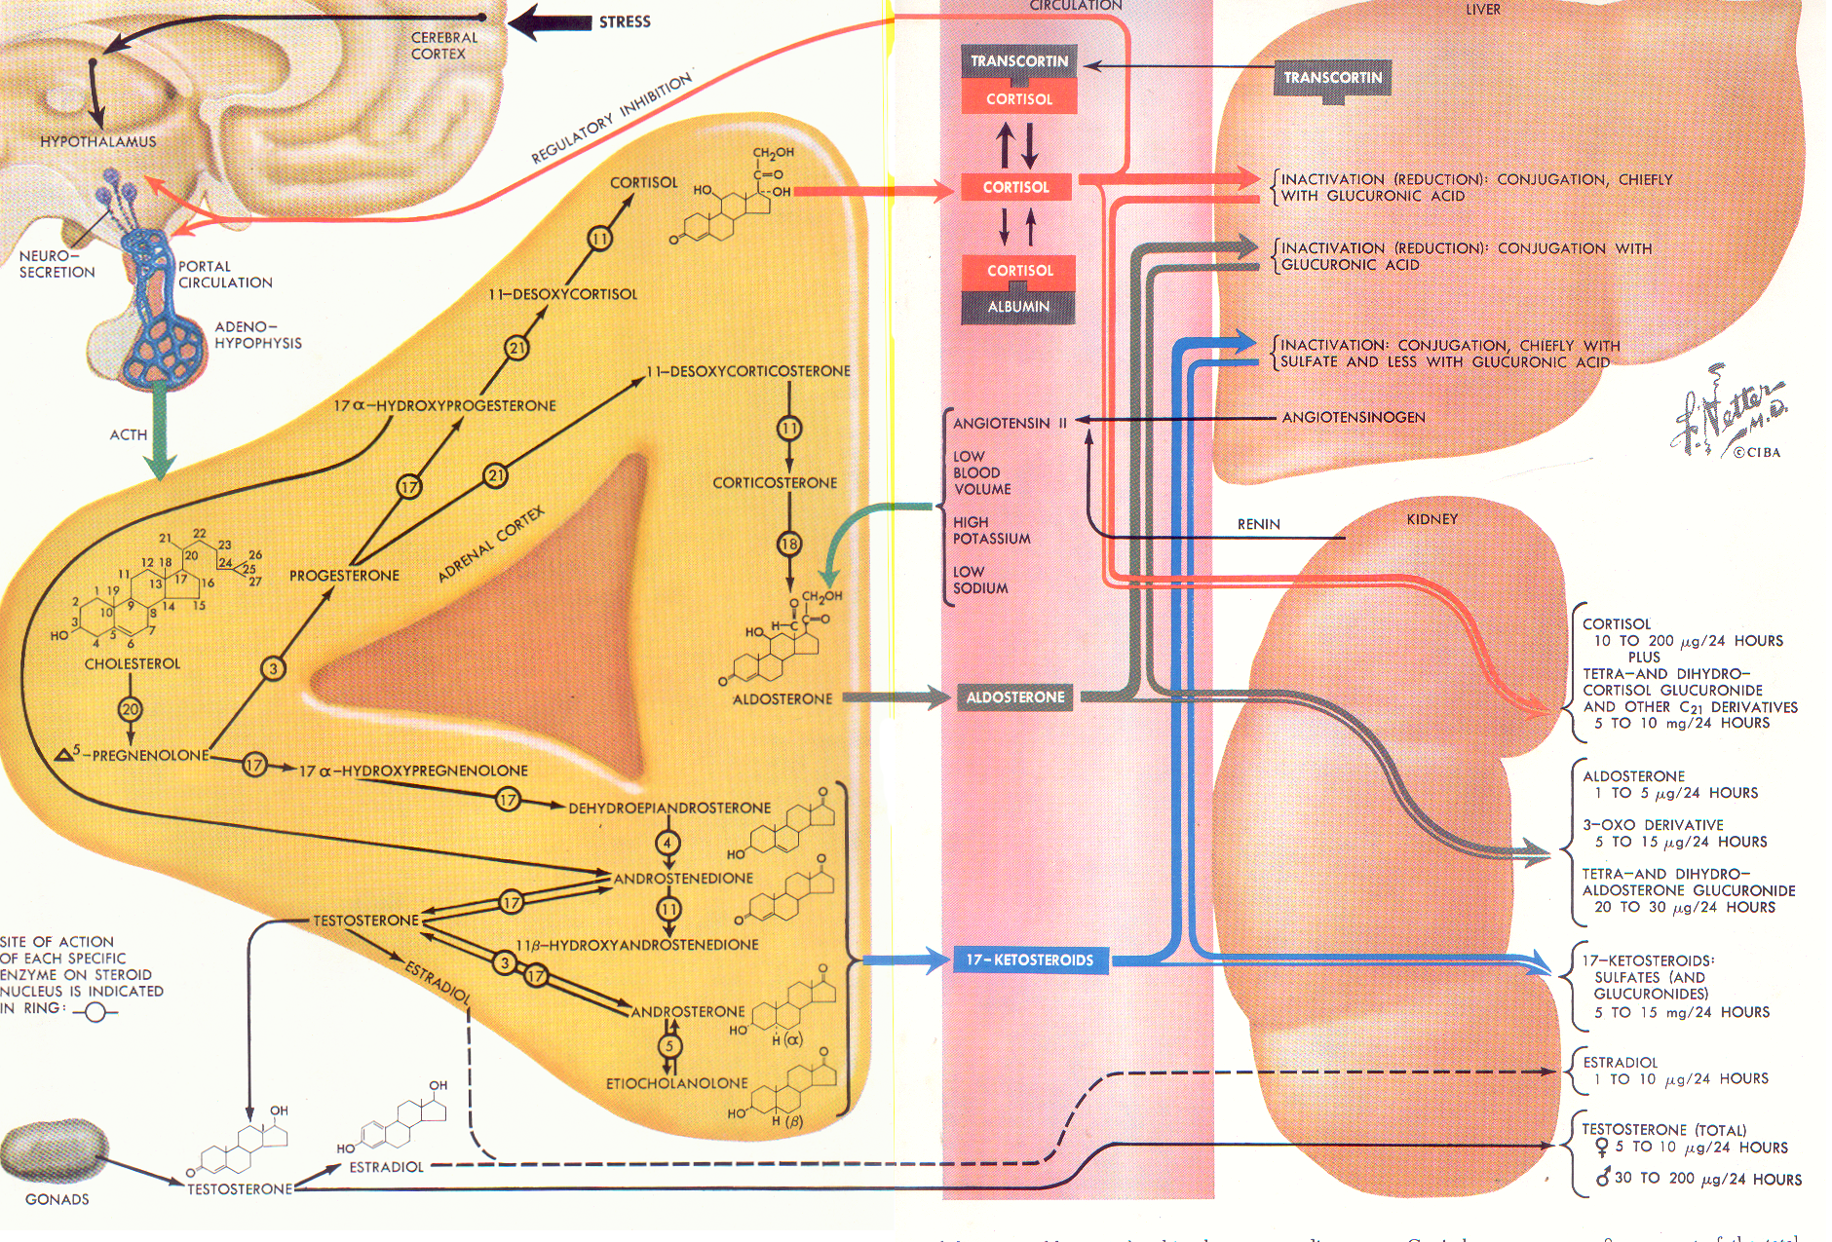

Slide 11
Tests for Adrenal Cortical Function:
A. By measuring the blood level of the hormone directly:-
1.Plasma cortisol (hydrocortisone) level.
- Normally 8 to 28 micrograms per 100 ml.
2.Other cortical hormones- Using Immunoassay
Aldosterone
B. By measuring the urinary output (24 hours) of the metabolites
17- Hydroxycorticoid ( for hydrocortisone)
17ketosteroid (for androgens and Oestrogens)
Free urinary cortisols
A.C.T.H. stimulation tests
A.C.T.H. suppression test

Slide 12
Hypercorticism:
Infantile
Pre pubertal
Adult Type
  Cushing Syndrome
  Adreno-Genital syndrome
Post menopausal
Primary Aldosteronism.

Slide 13
Hypercorticism/ Hypercorisolism
Hypercorisolism Cushing Syndrome
  High plasma cortisol levels
Adreno genital syndrome
  high 17 ketosteroid levels
hyper aldosteronism
  High aldosterone levels
One and two might overlap

Slide 14
Infantile
Due to androgenic excess, during intrauterine life.
Pseudo hermaphrodite
Presents at birth
Enlarged clitoris, Hypospaedias,
Difficult to determine Test.

Slide 15
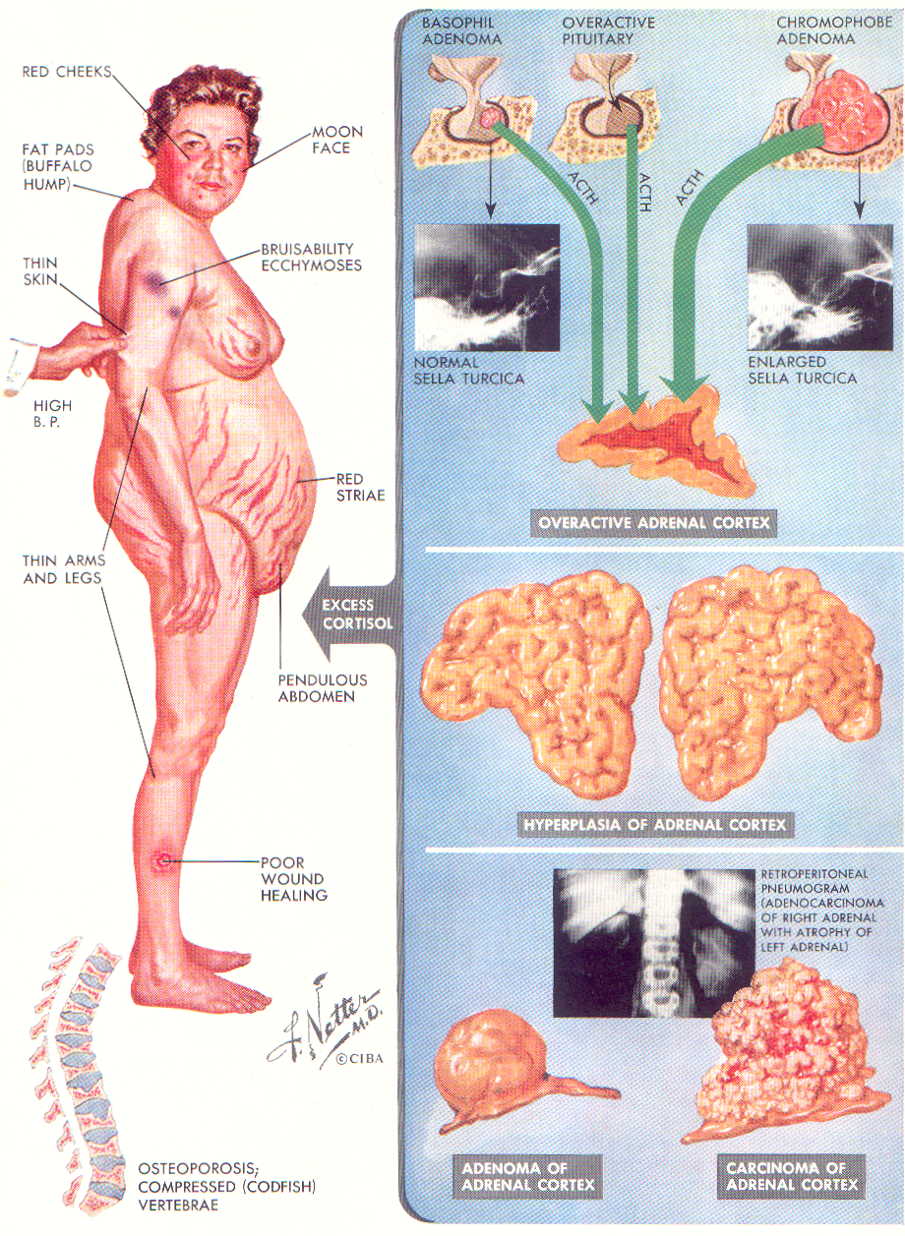
Cushing Syndrome:
Primary:
Cushing disease: Pituitary Tumors : 30%
Ectopic ACTH producing Tumour
Hyperplasia of adrenal gland: 60%
Tumor of adrenal cortex
  Adenoma
  Carcinoma
Tumours of: pineal gland, thymus.
Secondary:
Excessive steroid Therapy
  Rheumatoid arthritis
  Transplants Patients receiving Steroid therapy
  Auto immune disorders

Slide 16
Cushing syndrome
Female Male Ratio: 3:1
Age 15 to 50 years
Highly characteristic features
  Obesity,
  Hypertension,
  Diabetes
  Abdominal striae,
  Hirsutism,
  Menstrual disorder.

Slide 17
clinical features
May be divided into 5 broad groups:-
      1.Those due to metabolic disorders.
      2.Those due to fluid and
      electrolyte disturbances.
      3.Sexual disorders.
      4. Mental changes
      5. Other features.

Slide 18
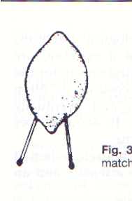
Those due to Metabolic Disturbances
Disturbances releted to fat, protein, sugar and calcium metabolism: -
1.Obesity: Although overall weight is not increased
  Deposition of fat in certain areas There is an excessive deposit of fat over
  Protuberant abdomen
  Buffalo lump (fatty pads over the scapulae)
  Moon face with pursed lips
  Obliteration of supraclavicular fossae.
2.Protein breakdown::
  Thinning of arms and legs due to muscle breakdown
  (the swollen abdomen with the thinned-out legs may be compared to
  ‘a lemon on the match-sticks’).
  Increasing muscular weakness.
3.Atrophy of the dermis and inhibitory effect on fibrous tissue:
Skin gets inelastic and assumes a tissue-paper consistency; on the abdomen :
striae gravidarum.
Purpura and bruising to minimal trauma
4. Diabetes, due to increased neoglucogenesis.
5. Negative calcium balance causing gross osteoporosis and, sometimes, pathological fractures (particularly of the vertebrae)

Slide 19
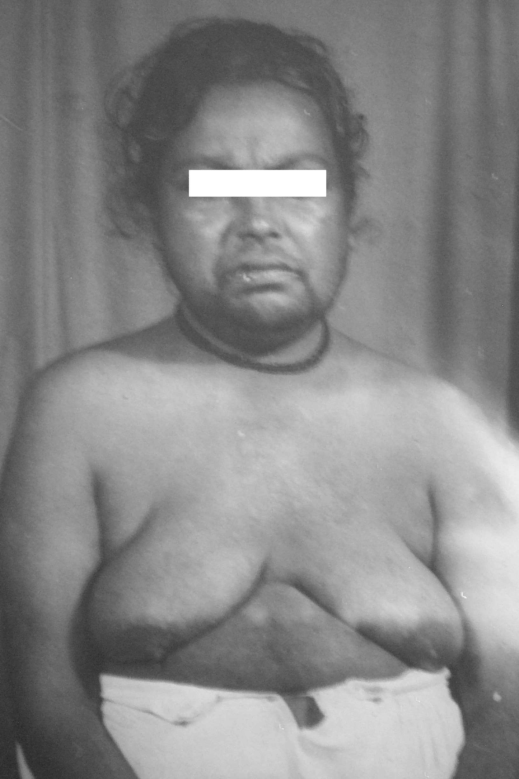
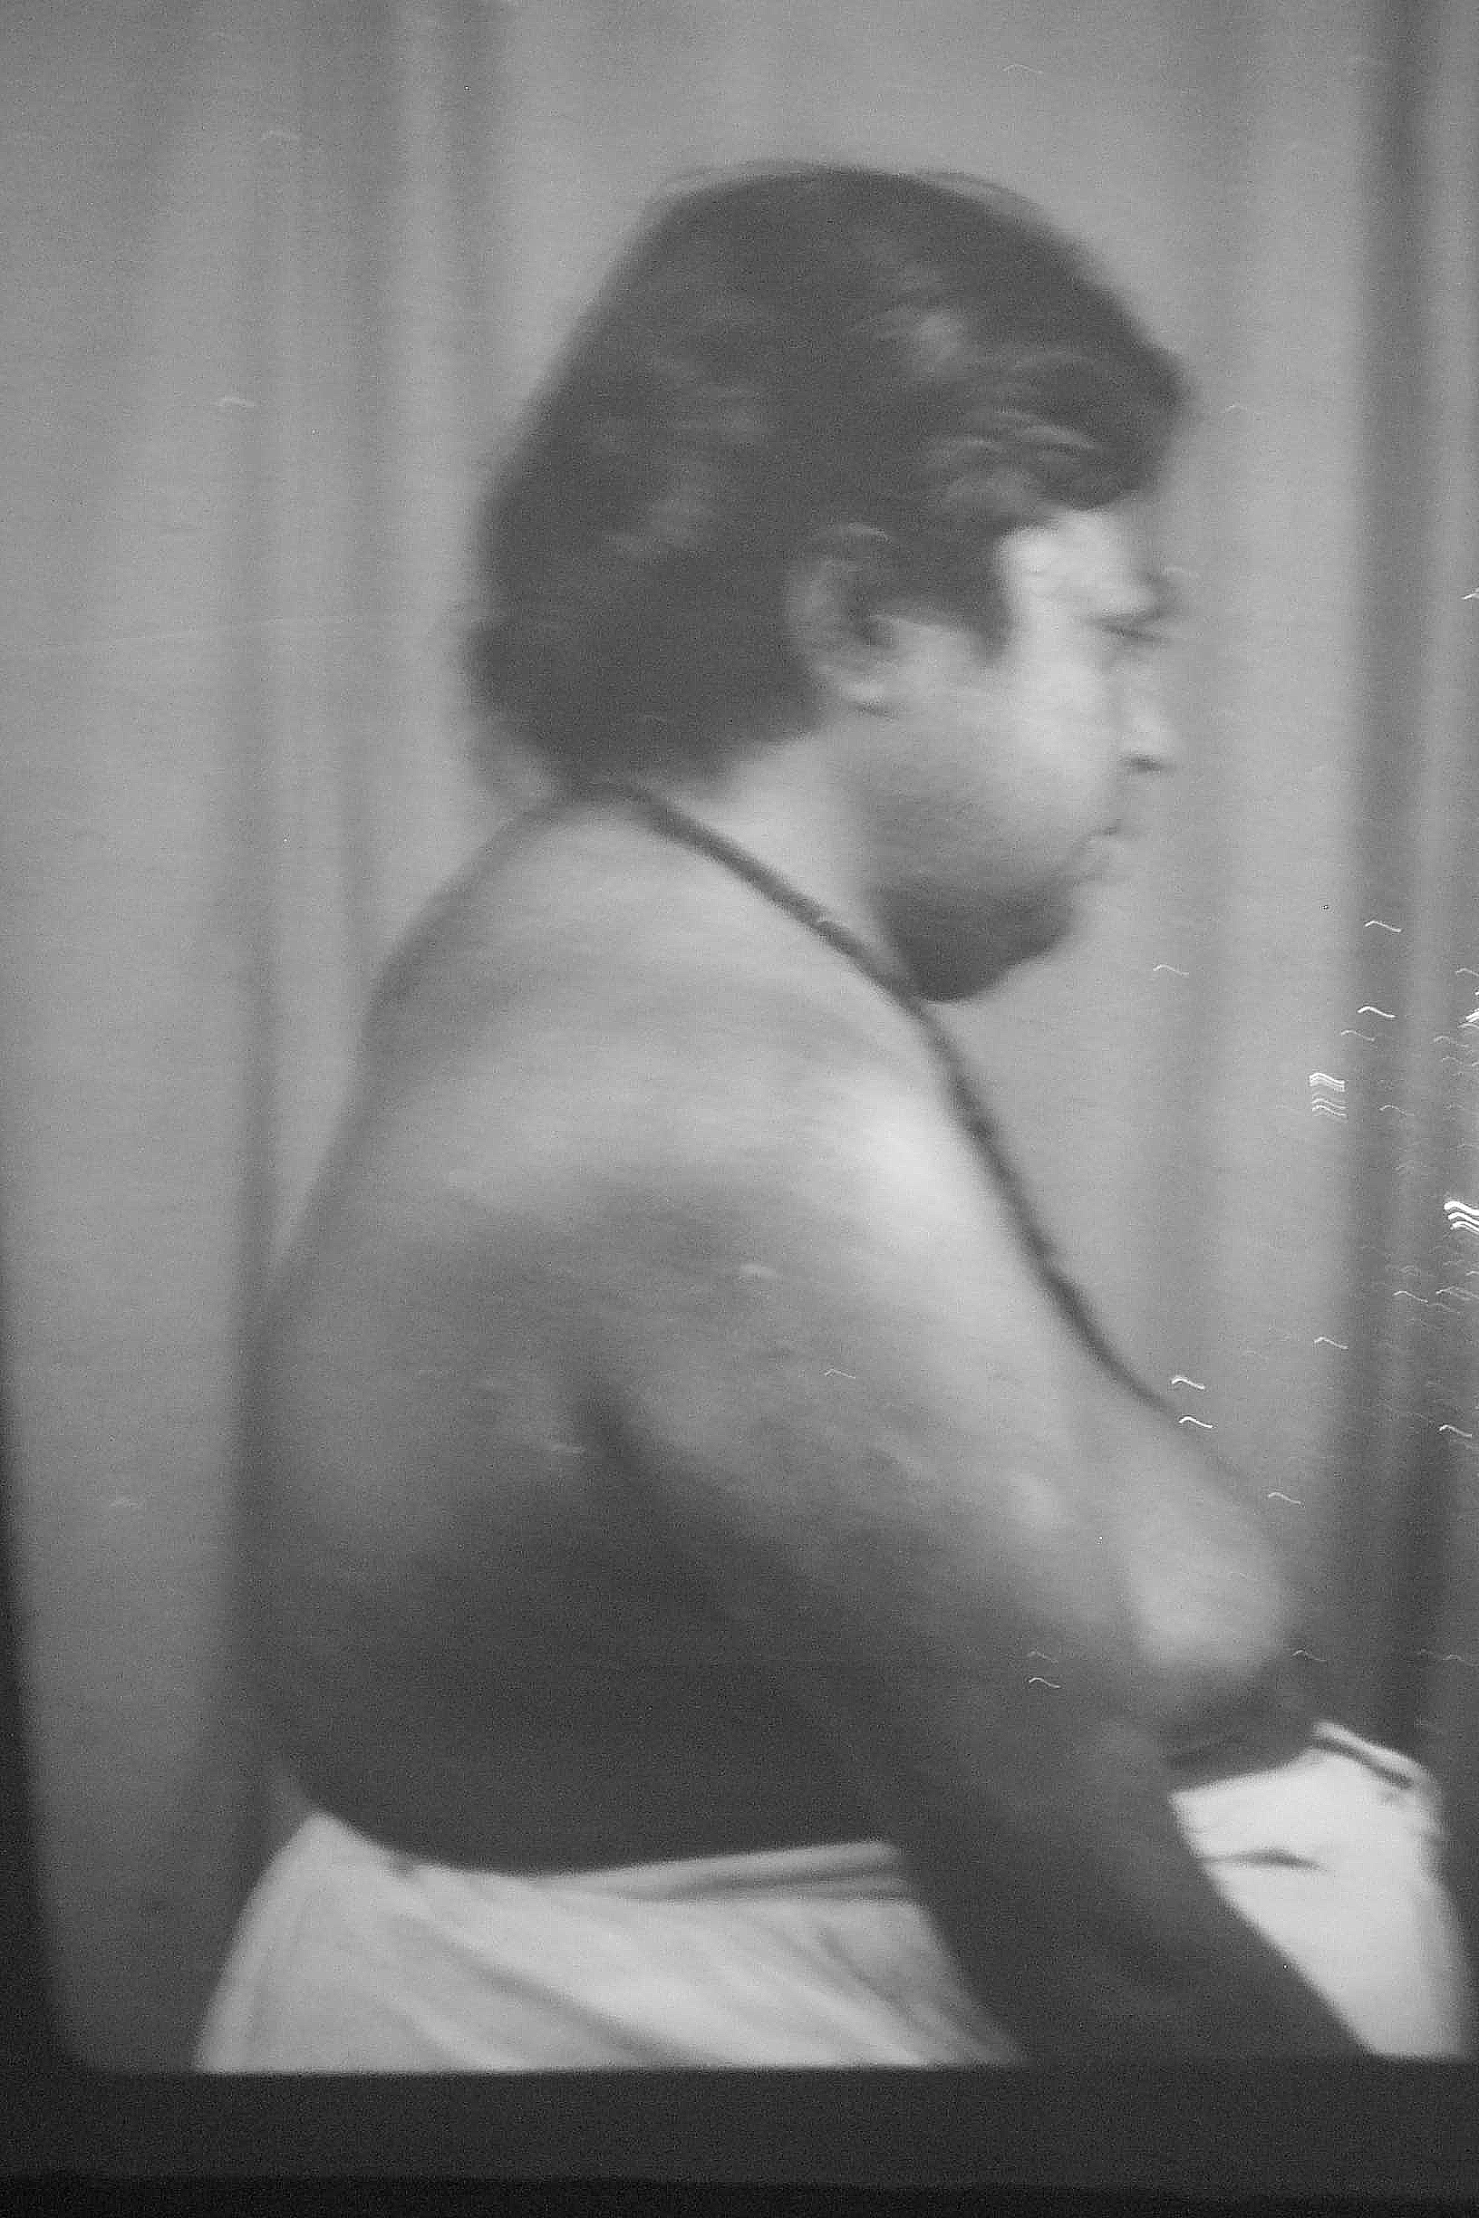

Slide 20
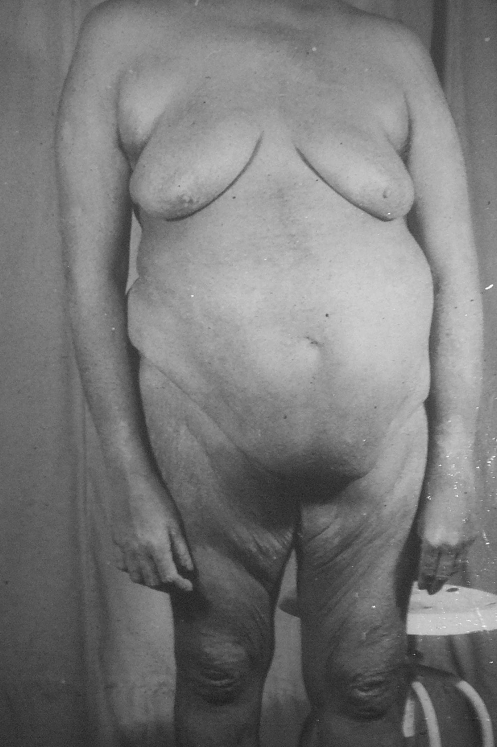
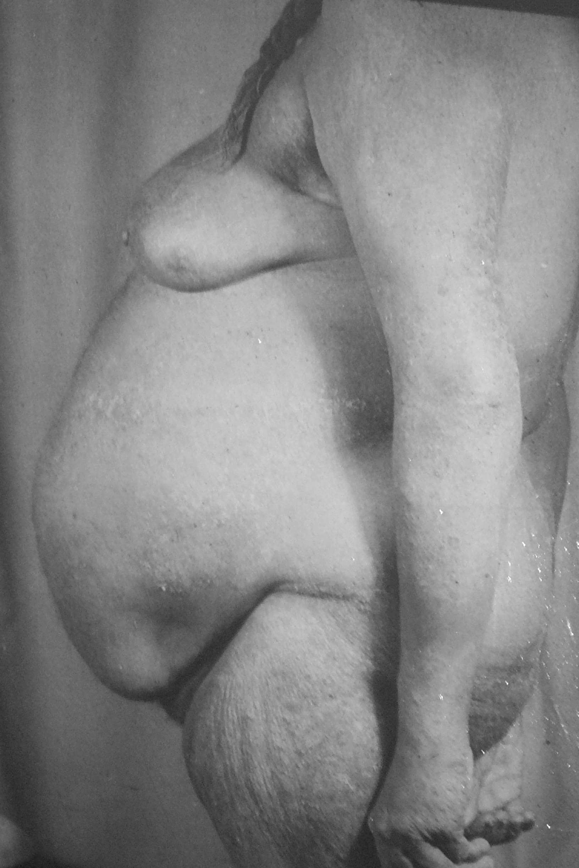

Slide 21
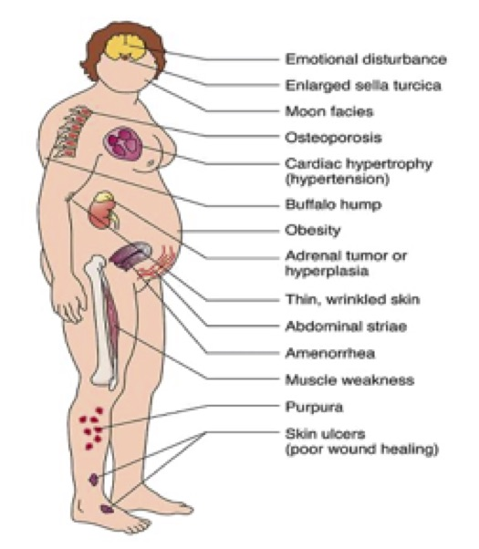

Slide 22
Those due to Fluid and Electrolyte Imbalance
Hydrocortisone has a weak Aldosterone effect.
Retention of sodium and water with excessive loss of potassium.
This results in:
  Hypertension, may lead to cardiac hypertrophy, myocardial ischaemia, cerebro-vascular accidents, and congestive heart failure.
  Hypokalaemic alkalosis

Slide 23
Sexual Disorders
1)Common types:
  Sterility and impotency in the males.
  Sterility and menstrual disorders in the females
  (oligomenorrhoea, amenorrhoea or menorrhagia).
(2)Uncommon type i.e. Adreno-genital Syndrome:
sexual disorders are more predominant than the metabolic disorders:
Due to excessive secretion of androsterone.
Oligomenorrhoea, atrophy of the breasts, enlargement of the clitoris, deepening of the voice, and a change of body structure to a manly build.
Young males ---- excessive seceretion of Oestrogens.
Gynaecomastia, atrophy of the testes, change in voice

Slide 24
Mental Changes:
Various types of psychosis may set in ( more than half of the cases).
Other Features:
(1)Increased growth of lanugo hairs,
sometimes frank hirsutism.
(2) Acne and skin infections
(due to suppressed inflammatory reaction).
(3) Recurrent intercurrent infections
(4) Excessive pigmentation of the skin
(Due to increased A.C.T.H.)

Slide 25

Cushing Syndrome

Slide 26
Special Investigations
(1)Blood Count – Polycythemia and leucocytosis
(with lymphopaenia and eosinopaenia).
(2) Urine Examination (a)Glycosuria (b) Hypercalciuria
(3) Blood Biochemistry: (a)Hyperglycaemia
(b) Hypercholesterolaemia.
(4) B.M.R. – Low.
(5) X -Ray:
  Skeleton- Gross osteoporosis, particularly in the vertebrae and pelvis.
  Pituitary fossa (sella turcica)- An enlargement may sometimes be seen if the condition is due to a pituitary tumour.
  IVP will show displacement of kidney

Slide 27
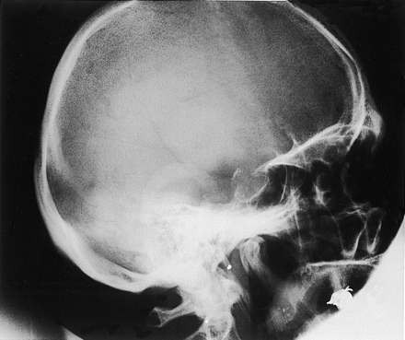

Slide 28
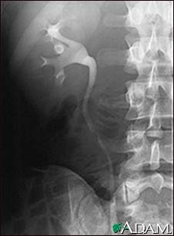

Slide 29
Cortisol Function Test
Plasma Cortisol Levels:
  Cushing Syndrome 8 to 28 mg /100 ml ( 220-780 nmol/liter)
Plasma ACTH levels
24 hours output of urinary steroids: cortisol product
  17 ketosteroid: Principle metabolite from
  Testosterone, androsterone etiocholanolong from Testes
Dehydroepiandrosterone, from cortex.
2/3 of cortex 1/3 Testes in males
All of it from Cortex in Females
9- 25mg /24 hrs in males
8-12mg/24 hrs. in Females
Test for adreno-cortical function + Testicular
  17 Hydroxy Steroid
      All urinary steroids are oxidized
      Converted steroids are mead
      80 to 90% cortisol metabolites can be measured.
      8 to 13 mgs/24 hrs.
  24 hours Free urinary cortisol level
    > 100 micro gm /24 hours +

Slide 30
Localization of cause of
Cushing Syndrome
Pituitary Cushing Disease:
ACTH high, Both are stimulated
17 Keto + 17 Ketogenic
Cortical adenoma,
A.C.T.H. low, Androgens low
17 Keto (Normal) + Ketogenic ( 2 to 4 times)
Cortical Carcinoma
Aberrant sterodogenesis
Very high 17 Ketosteroids ( 40 – 100 mgs)
Ectopic ACTH producing tumour
Ketogenic high 4 times of Ketosteroids

Slide 31
A.C.T.H. suppression tests
High dose dexamethasone Test
2mg dexamethasone 6 hrly for 4 days
Plasma Cortisol ,Urinary free Cortisol
and 17 hydroxy Cortisol levels decrease
by 50 % in Pituitary adenoma
Adrenal hyperplasia,A.C.T.H. Producing Tumour Ectopic ACTH producing tumour No effect
A.C.T.H stimulation. test Metyrapone Test
11 deoxy cortisol cortisol
30mg/kg 750mg every four hours for six doses
Pitutory adenaoma patients increase in ACTH secreation and increase in urinary
17 hydroxy steroid
No effect in others
CRH test Pituitary Cushing disease from ectopic ACTH tumour: 1micgm/kg---- Plasma ACTH levels go up

Slide 32
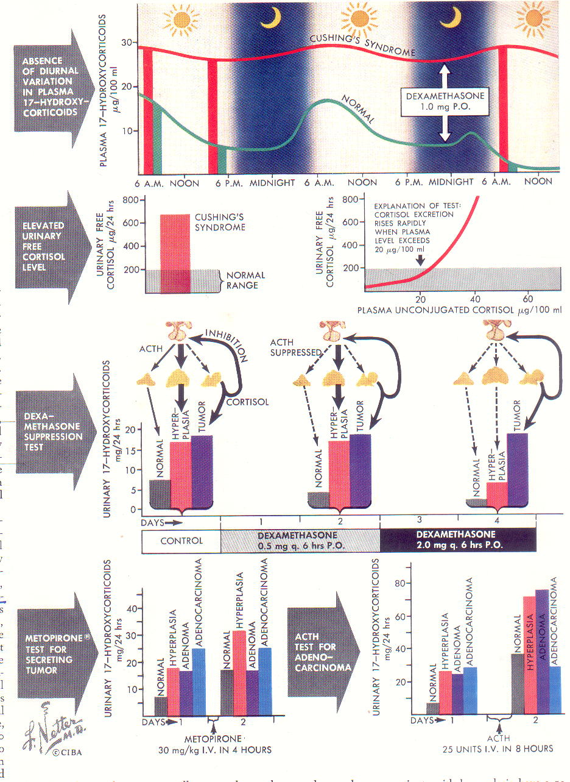

Slide 33
CAT scan in Cushing Syndrome
For Pitutory tumours of size 5-10 mm can be diagnosed
95% Sensitivity for Adrenal localisation
Adenoma can mimic Pheochromocytoma
Hyperplasia on one side and hypoplasia on opposite side
Cannot dignose micronodular hyperplasia

Slide 34
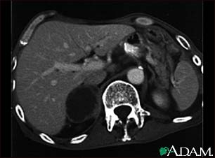
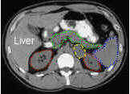
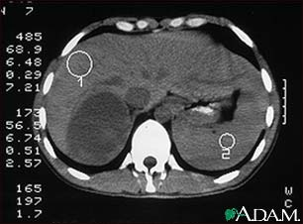
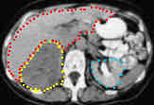

Slide 35
MRI scan in Cushing Syndrome
Better modality for Pitutory tumours
Gadolinium MRI is still better
Does not diagnose Micro adenoma
Better modality for adrenal pathology as on T1 weighted image both Primary and mets appear darker than Liver
Pheochromocytoma appears 3times brighter

Slide 36
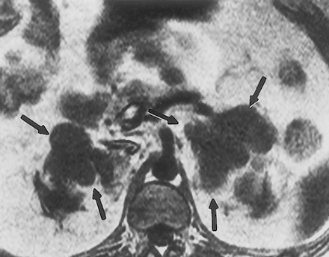

Slide 37
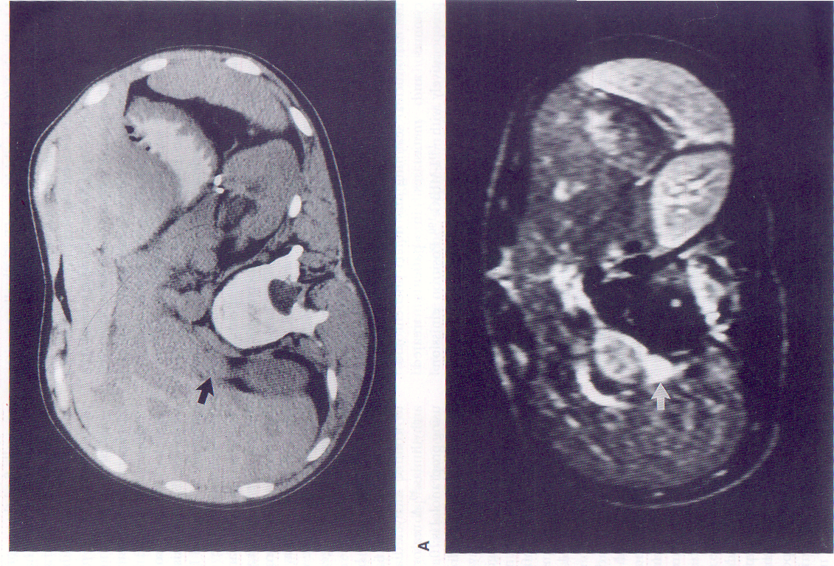

Slide 38
Nuclear scan in Cushing Syndrome
I 131 iodomethyl norcholesterol scan
Selective for hypercorticism
Differentiate adenoma ,Carcinoma and hyperplasia

Slide 39
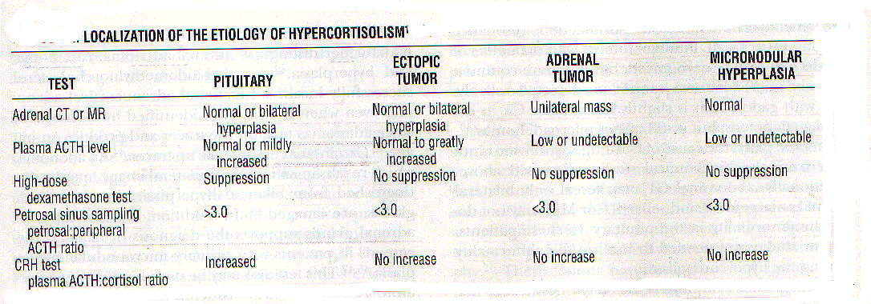

Slide 40
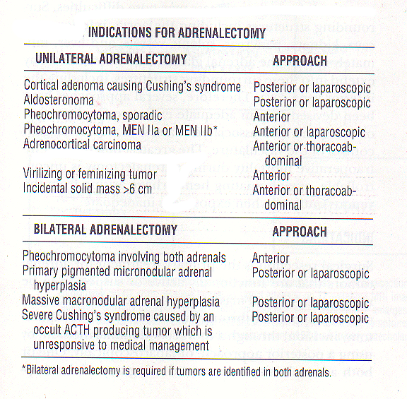

Slide 41
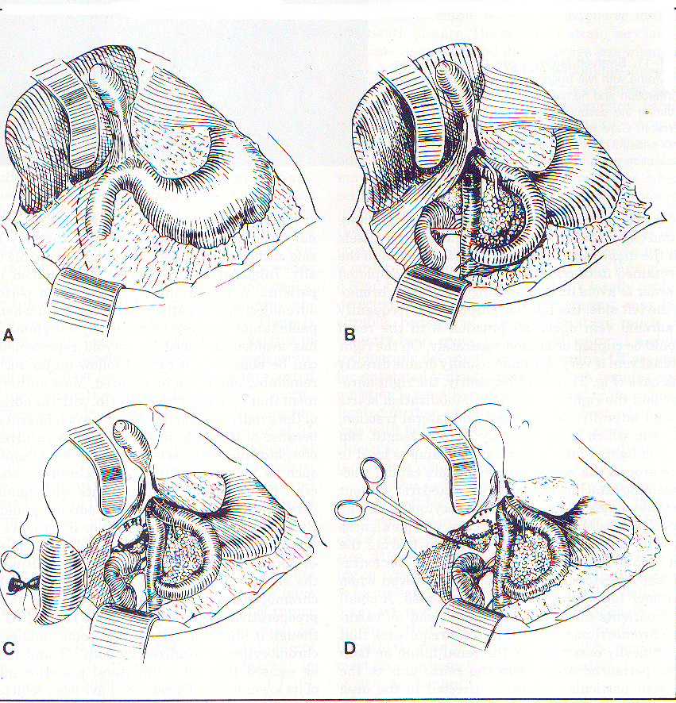

Slide 42
