Slide 1
CARCINOMA BREAST
.

Slide 2

Prof Dr. Arun Jamkar,
M.S. Ph.D. ( Surgical Oncology),
FICS, FIAGES, FMAS, FAMS FAIMER fellow
Former Vice Chancellor,
Maharashtra university of Health sciences, Nashik
Consultant,
Persistent systems ltd, Pune
Distinguished Professor ;
Symbiosis International University,
Pune.
Chief Medical Officer,
Index Technology, Cupertino USA
Director Academics,
Galaxy care hospitals, Pune

Slide 3
INTRODUCTION
Modified sweat gland
Develops from ectodermal ingrowths along milk line

Slide 4
Blood supply
Perforating branches of internal mammary artery
Lateral branches of post intercostal arteries
Axillary artery-
highest thoracic,
lateral thoracic,
pectoral br of thoraco-acromial artery

Slide 5
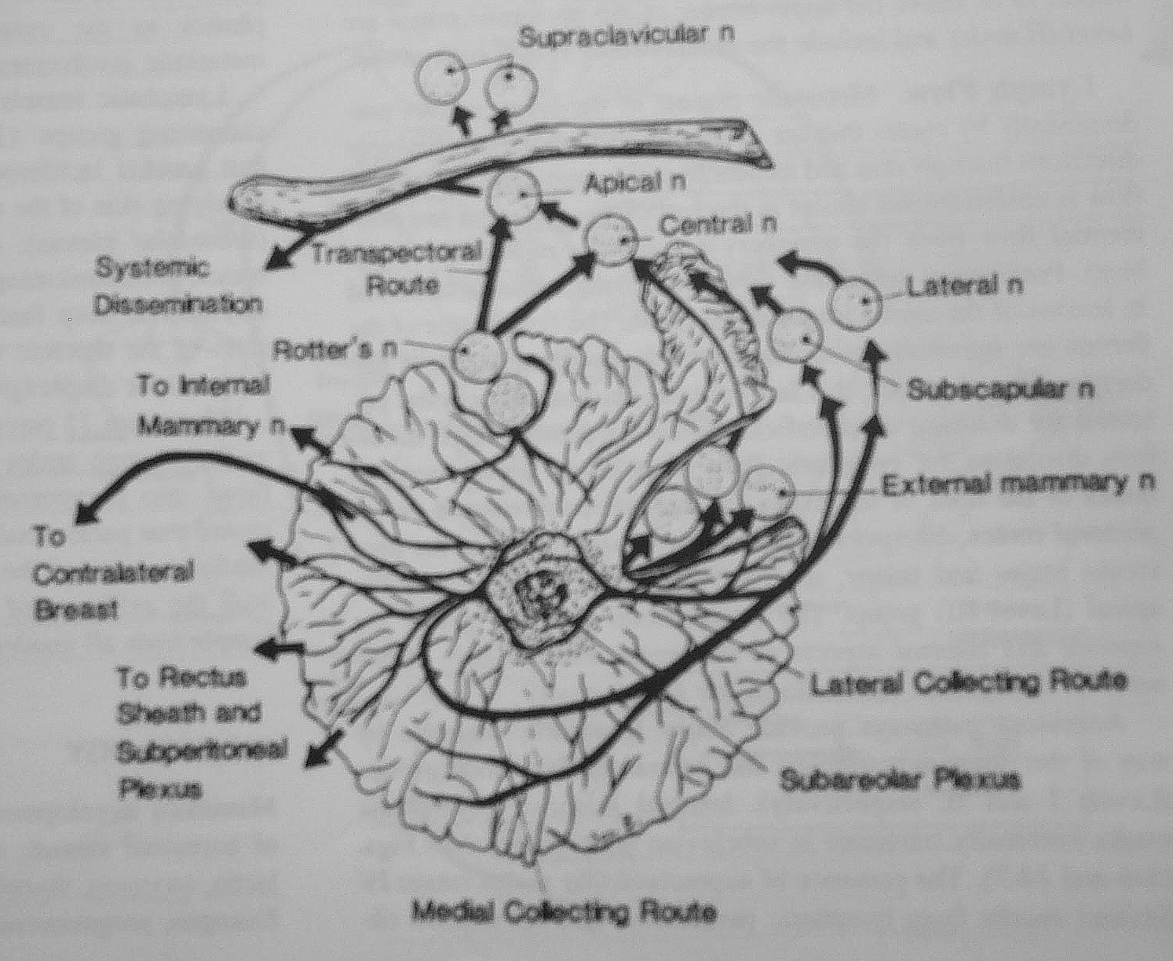
LYMPHATIC DRAINAGE
Pectoral
Axillary
Subscapular
Central
Apical
Interpectoral
Internal mammary

Slide 6
CA BREAST
Incidence:-
-leading cause of death in women next only to lung ca
-32% of all female malignancies
-1 mil new cases diagnosed yearly
-common in whites with England & Wales having highest mortality rate
-Japanese and Filipino women have the lowest rate
-common in Nuns & Jewish women

Slide 7
Etiology
Genetic factors-
BRCA 1- ovarian Ca
BRCA 2- male breast Ca
SBLA syndrome
Cowden’s disease
Diet-
high fat, alcohol- inc risk
omega-3 fatty acid & phytoestrogen decrease risk

Slide 8
Hormone usage-
Estrogen- slightly risk in peri&post menopausal
Combined pills- no evidence.
Child bearing, breast feeding & menopause-
Infertility and nulli-parity risk
risk with age at first full term pregnancy(till35).
Breast feeding is said to the risk.
Early menopause(<45) risk than late(>55)
Surgical menopause is protective
Obesity- associated with risk. (post menopausal)
Irradiation-

Slide 9
Clinical presentation
Early –
-lump in breast,
- changes in nipple-discharge,retraction,
paget’s disease
-puckering of skin
Locally advanced-
edema of skin(peau d’ orange)
fixity to skin / pectoral muscle
Fungating growth, axillary&/ supraclavicular
swelling, ‘cancer en cuirasse’, U/L edema.
Distant metastasis-
back ache, pain abd, path #,
chest pain, pleural effusion.

Slide 10
Classification (Foote &Stewart)
Paget’s disease of nipple
Carcioma of duct origin
a) Intra ductal(in-situ) non infiltrating
b) Infiltrating
i. Scirrhous
ii. Medullary
iii. Comedo
iv.Colloid
v.Papillary
vi.Tubular

Slide 11
3)Carcinoma of mammary lobule
a)Nonfiltrating( in-situ)
b)Infiltrating
4)Relative rare carcinomas – melanoma,adenoid cystic,Sq.cell,sweat gland, metaplastic.
5) Sarcoma

Slide 12
Investigations
FNAC
Mammography
Biopsy( Tru-cut,incision, excision )
USG
ER/PR
Work up for metastasis
Prognostic factors

Slide 13
STAGING(AJCC 2002)
TUMOR SIZE (T)
T1– 2 cm or <
mic – microinvasive < 0.1cm
1a -- > 0.1cm < 0.5cm
1b -- > 0.5cm < 1cm
1c -- > 1cm < 2 cm
T2 -- 2cm – 5cm
T3 -- > 5 cm
T4 -- a- extn to chest wall
b- extn to skin
c- a & c
d- inflamatory

Slide 14
NODES (REGIONAL LN )
N0– no lymph node mets
N1– mobile ipsilateral LN
N2– a)fixed ipsilateral LN
b)ipsilat int.mammary
N3– a)ipsilat infraclavicular
b)ipsilat axillary + internal mammary
c)ipsilat supraclavicular.
DISTANT METASTASIS (M)
M0– no distant metastasis
M1– distant metastasis

Slide 15
STAGE
STAGE | T | N | M
Stage 0 | T is | N0 | M0
Stage I | T1 | N0 | M0
StageIIA | T0 | N1 | M0
 | T1 | N1 | M0
 | T2 | N0 | M0
StageIIB | T2 | N1 | M0
 | T3 | N0 | M0

Slide 16
StageIIIA | T0 | N2 | M0
 | T1 | N2 | M0
 | T2 | N2 | M0
 | T3 | N1 | M0
 | T3 | N2 | M0
StageIIIB | T4 | N0 | M0
 | T4 | N1 | M0
 | T4 | N2 | M0
StageIIIC | Any T | N3 | M0
StageIV | Any T | Any N | M1

Slide 17
TREATMENT
Early breast cancer.
1) BCT +/-- adjuvant therapy
2) MRM
All BCT receive ext RT

Slide 18
LABC(T3,T4,N2,N3)
Operable LABC MRM
4 cycles AC
RT
2 cycles TAXENE
Inoperable LABC 4 cycles AC
MRM
RT
2 cycles Taxene

Slide 19
Metastatic-
Chemo,RT,
Surg for local control,
Harmonal therapy- Tamoxifen, Letrozal, Bi-phosphonates.

Slide 20
THANK YOU

